Slide 1
National Single Window System

Slide 2
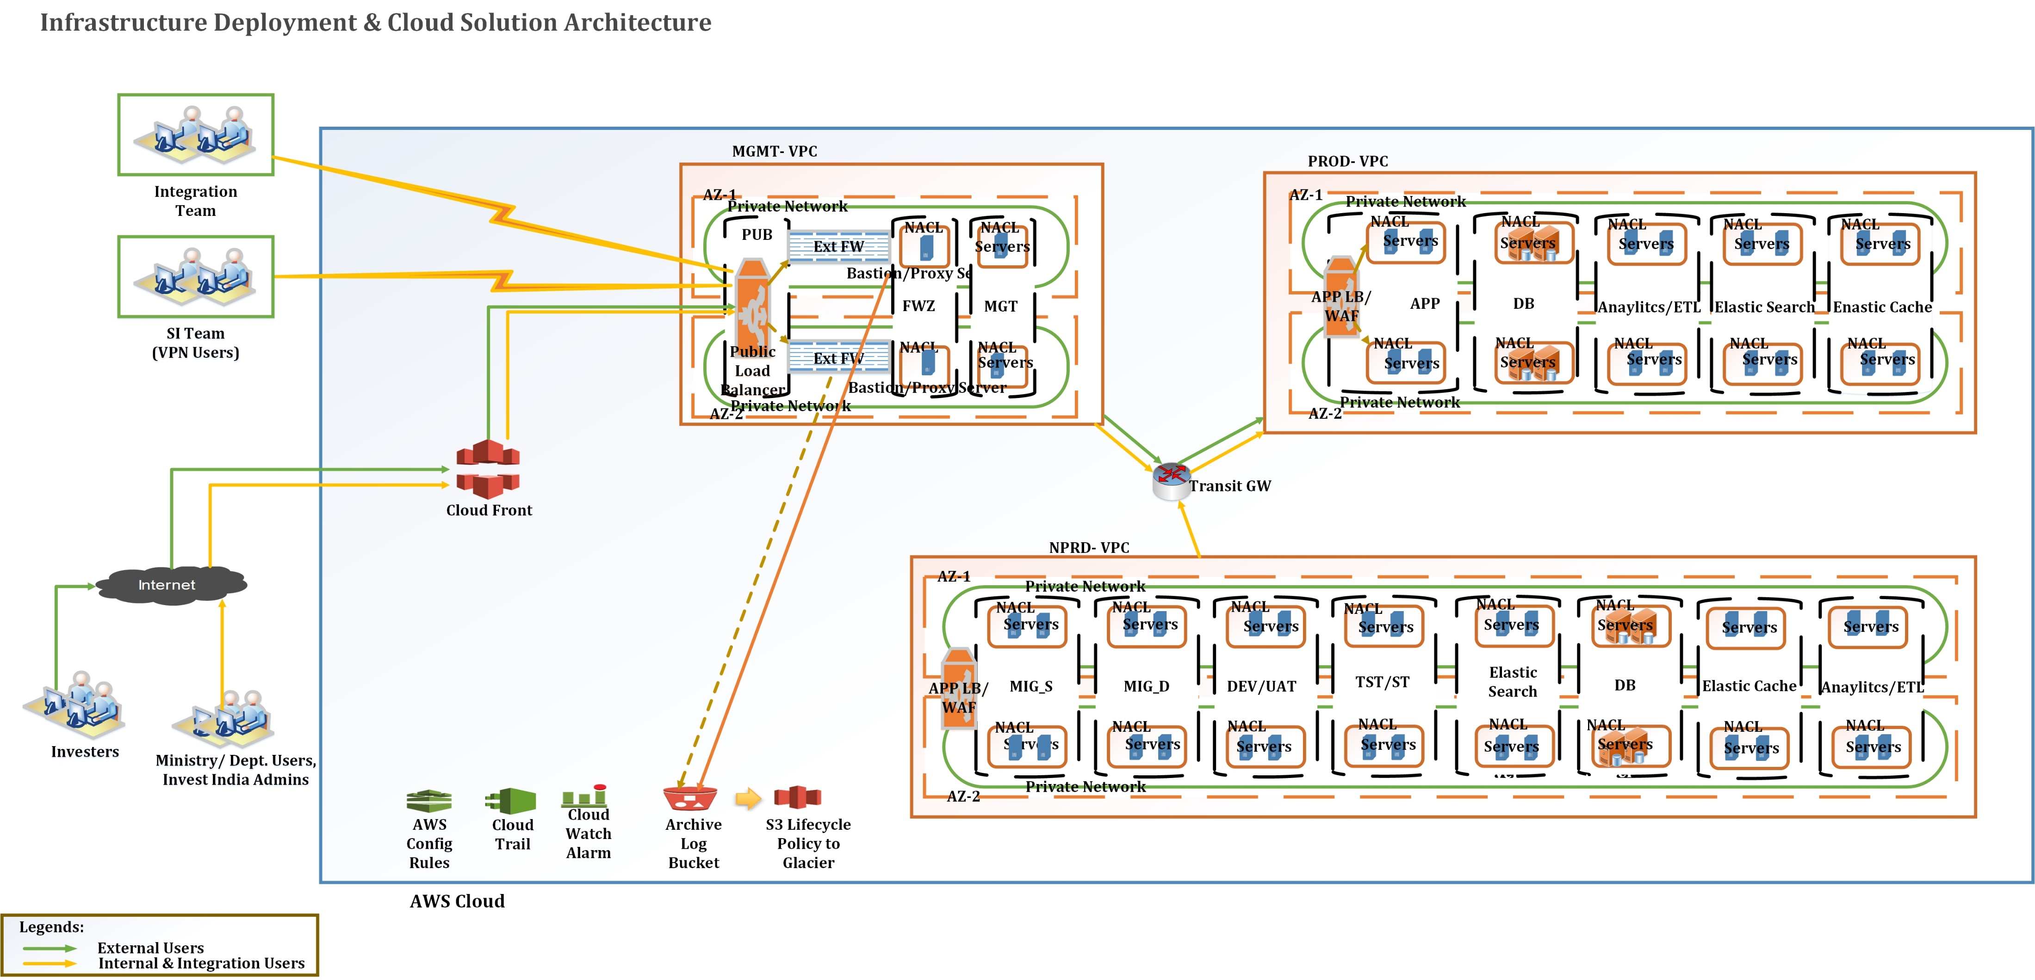
Deployment Architecture

Slide 3
Integration Architecture
License Details
License Status
Client 1
Department 1
DX Application 2
API Gateway
Raise Clarification
Client 2
Department 2
DX Application 2
Pull Clarification
Client 3
Department 3
DX Application 3
Payment
Client n
Department n
DX Application n
Acknowledgment
Document APIs
Client x
Department x
DX Application x
Ministry Specific Adapter
Invoking Department API
Department y
DX Application y
NSWS Portal
SSO ( SAML)
Department Portal

Slide 4

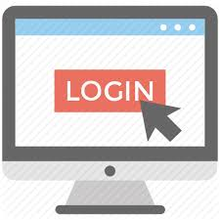



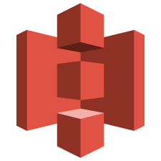
Application Architecture
Ministry Portal
Keycloak SSO
Kafka Producer
AP
I Ga
t
eway
AP
I Ga
t
eway
Database
Ministry
Officer
Investor Portal
Ministry Dashboard Micro services
Investor Portal related Micro services
Investor
Database
Integration Micro services
Ministry
/State System
Kafka
DMS API
Ministry specific Adapter
Payment Gateway
Kafka Consumer
Document DB
S3
Application DB

Slide 5
Investor Portal Sizing
24 Containers (12 in AZ1 and 12 in AZ2) which has 2.0 vCPU with 2 GB memory which is autoscaling between 2 to 10 for the following Services
Homepage (Drupal)
Frontend (ReactJS)
Keycloak (Authentication)
JAVA config, Zuul Gateway, Admin, Auth, KYA, Form Builder
Integration
Notification
User Management
2 Nodes for Kubernetes Cluster (32 vCPU with 128 GB memory each node)
Database – Aurora (8 vCPU and 64 GB memory with multi AZ)
S3 – For all images and static contents

Slide 6
Integration - Sizing
32 Containers (16 in AZ1 and 16 in AZ2) which has 2.0 vCPU with 2 GB memory which is autoscaling between 2 to 10 for the following Services
ReactJS, Gateway, Document, Eureka, User Service
License Worklist, Ministry Department Details
User OTP Service
License PDF Generator, KAFKA, Wrapper API
JSON Convertor, License, Payment
Clarification, Acknowledgement
2 Nodes for Kubernetes Cluster (32 vCPU with 128 GB memory each node)
Database – MySQL RDS (8 vCPU and 64 GB memory with multi AZ)
AWS Document DB (8 vCPU and 64 GB memory with multi AZ)
S3 – For all Document Management System

Slide 7
Application and Infra Security
Fortigate Firewall – VM 16
DDOS (Currently in Learning mode)
AWS WAF – Web Application Firewall (Currently in Learning mode)
Deep Security – Host Intrusion Prevention System
Guard Duty – AWS as Service (Analyze malicious traffic)
Patch Management – AWS Patch Manager
Network Access Control List
Security Group
Transit Gateway – Routing across VPC’s
VPN Access through Firewall (Authentication via AD)
System audit Logs
Application Logs, S3 and Database Backup

Slide 8
System and Application Monitoring
24/7 NOC Operations – Well trained associates monitoring the infrastructure and Application services uptime
CloudWatch – CPU, Firewall, Kafka, Container, memory monitoring
PMON – Infra and Application (In-progress) Monitoring
Prometheus & Grafana (To be done)
Kibana for Log Monitoring

Slide 9
Application Deployment Process Flow
Git/SVN Repository
Developer
Git Commit
Build
Jenkins
Artifact Build
Docker Image Build
Elastic Container Registry
Deploying in Kubernetes
Mail
Docker Build
Image Push to ECR
Image Pull
Notifications

Slide 10
Thank You

